Slide 1
www.cors.surveyofindia.gov.in
Survey of India

Slide 2
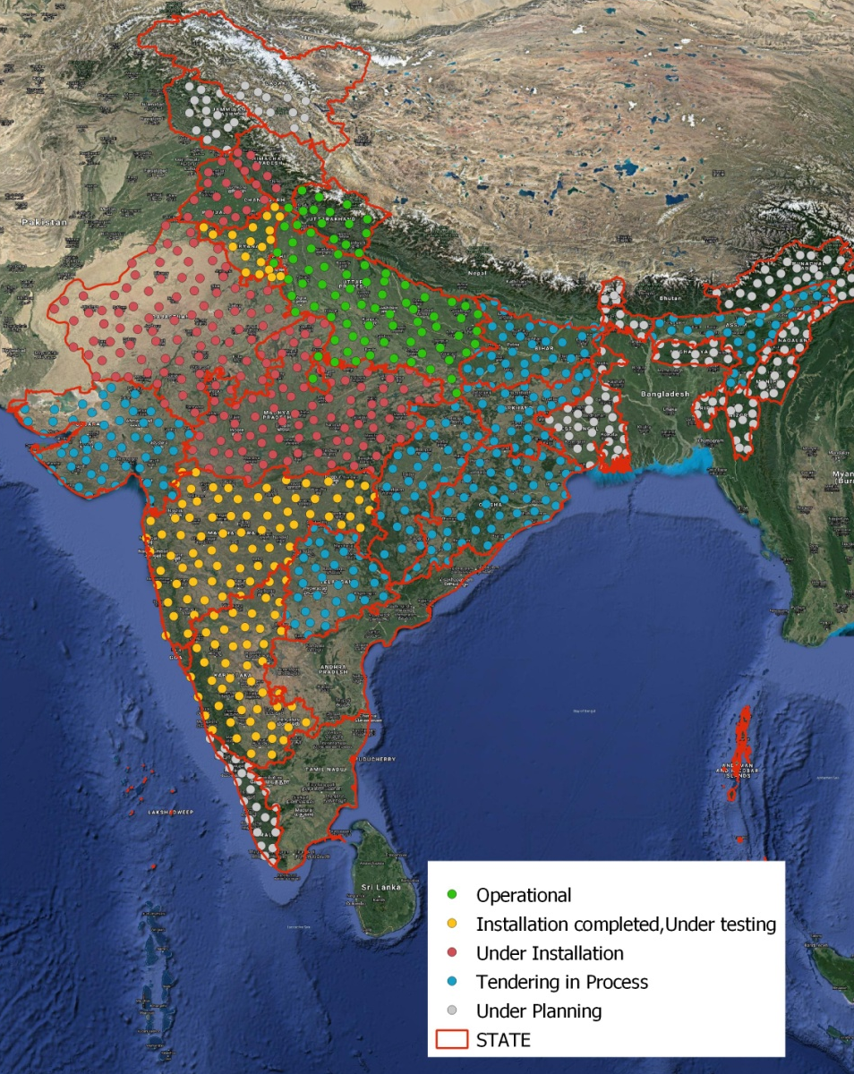
Continuously Operating Reference Station
Continuously Operating Reference Station Network Status
Survey of India has established a network of Continuously Operating Reference Stations (CORS) in Uttar Pradesh and Uttarakhand which is capable of providing Real Time Positioning Service through RTK/NRTK with an accuracy of ±3cm.
The CORS Network in Haryana, Maharashtra and Karanataka will be operational within 2 months.
The CORS Network in Punjab, Himachal Pradesh, Madhya Pradesh, Rajasthan is in Progress and may be operational in 3 to 4 Months.

Slide 3
www.cors.surveyofindia.gov.in -Portal
CORS infrastructure is basically a Network of permanently installed reference stations (or GNSS receivers), continuously streaming raw satellite observations to a central server.
The Central sever archive and catalogue these reference station data, analyses and process it for further consumption and host it over web to be used by users.
The CORS network is available 24 hours per day, 7 days a week and 365 days a year. Its data and corrections are hosted on web in form of open non-proprietary Data streaming standards for easy consumption.
These data/services are available on www.cors.surveyofindia.gov.in

Slide 4
www.cors.surveyofindia.gov.in
Following Services are being Provided by VORS Network
Real Time positioning Services
Network RTK Services for 3 – 4 centimeter real time positioning.
D-GNSS Services for 30 – 40 centimeter accurate real time positioning.
Reference Data Services
Online Data processing of static observation with respect of CORS.
Downloading of RAW Data of CORS Stations for processing in user software.

Slide 5
www.cors.surveyofindia.gov.in - Registration
To access these services, user requires login ID credentials. For which user users are required to get them registered and subscribe for requisite services on CORS portal i.e.
www.cors.surveyofindia.gov.in

Slide 6
www.cors.surveyofindia.gov.in - Registration
Click on Register

Slide 7
www.cors.surveyofindia.gov.in - Registration
Fill in details and click next

Slide 8
www.cors.surveyofindia.gov.in - Registration
Fill in details and click next

Slide 9
www.cors.surveyofindia.gov.in - Registration

Slide 10
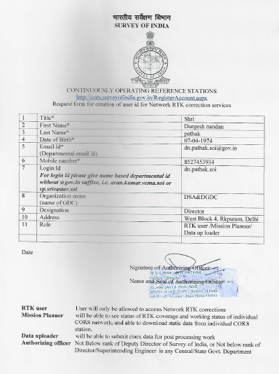
www.cors.surveyofindia.gov.in - Registration
Fill in form and email to
cors-grb.soi@gov.in

Slide 11
www.cors.surveyofindia.gov.in - Applications
Access Real Time positioning Services Requirement at user end
RTK/DGNSS enabled GNSS instrument (preferably Multi constellation)
compliant with RTCM and NTRIP protocol
Controller (Tab/ Mobile/Laptop etc)
Windows/IOs/Android
RTK field Software (Trimble Access, Leica Zeno connect etc)
With requisite DGNSS/RTK license

Slide 12
www.cors.surveyofindia.gov.in -Services
Network RTK/D-GNSS Services
Real time positioning with 3 to 4 cm / 30- 40 cm accuracy can be obtained through NRTK and D-GNSS services hosted by CORS respectively.
These Real time correction streams are available online which can be accessed by RTK/DGNSS enables GNSS rovers on following
HostIP: | 103.205.244.106
Port: | 2101
Login: | Your Username and Password

Slide 13
www.cors.surveyofindia.gov.in - Applications
Access Real Time positioning Services

Slide 14
www.cors.surveyofindia.gov.in - Applications
Reference Data Services

Slide 15
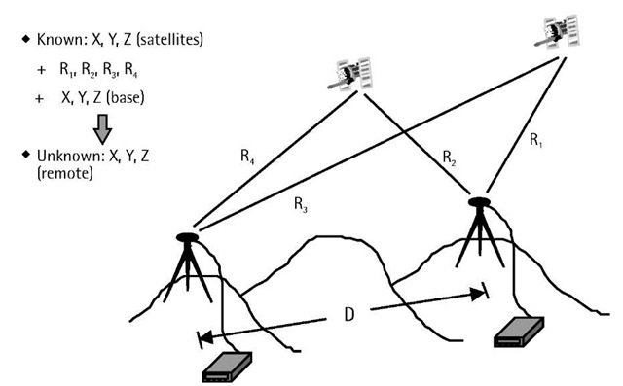
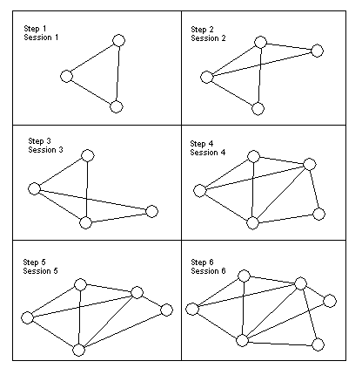
www.cors.surveyofindia.gov.in - Applications
At present, for GNSS Control work, GNSS instruments need to be paired to simultaneously observe Master (Station whose coordinates are known) and Rover (Stations whose coordinates need to be measured) or for more precision work Multiple masters and multiple rovers stations are observed simultaneously to form well conditioned geometries (Triangles, or braced quadrilaterals etc).
.

Slide 16
www.cors.surveyofindia.gov.in - Applications
Duration of observation in these cases, increases with respect to distance between Master and Rover stations.

Slide 17
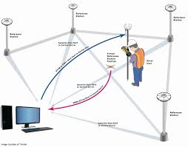
www.cors.surveyofindia.gov.in - Applications
With CORS in place, there is NO need to send paired GNSS equipments or forming geometrical networks. Using single GNSS equipment, control points with respect to National Reference frame can be established with much lesser observation period and better reliability and consistency in Survey work.

Slide 18
www.cors.surveyofindia.gov.in - Applications
User can choose out of above said 2 services. He can either
Process its GNSS data with reference to CORS Network online on above said website,
or
Download RINEX data of nearby CORS stations and using them as master stations, process his static observation data in his own GNSS processing software.

Slide 19
www.cors.surveyofindia.gov.in -Services
Online Data Processing
Users interested in sub centimeter precise positioning for Control work or users who do not have RTK enabled GNSS instrument or software, can also utilize CORS Services.
At present, in Static mode surveys, GNSS instruments need to be paired to simultaneously observe Master (Station whose coordinates are known) and Rover (Stations whose coordinates need to be measured)
Multiple masters and multiple rovers stations are observed simultaneously to form well conditioned geometries (Triangles, or braced quadrilaterals etc).
Duration of observation in these cases, increases with respect to distance between Master and Rover stations.
With CORS in place, there is NO need to use paired GNSS equipments or forming geometrical networks.
User can put his GNSS rover, on his point of interest, collect data in static survey mode and upload his data in Rinex format into online processing platform. Online processing platform will process data and provide coordinates of site along with Processing report.

Slide 20
www.cors.surveyofindia.gov.in -Services
Downloading of RAW Data of CORS Stations for processing in user software.
Users can download CORS stations raw observations in non proprietary open RINEX format or virtual rinex data and use it to process his own GNSS data it his own software.
By logging in on this website user can create custom orders; individual stations or multiple stations, epochs, time periods, and various formats such as Rinex2.1, Rinex 2.11, Rinex 3, T02, TGD, DAT, T01 and various logging rate 1 minute, 15 seconds, 1Hz, 5Hz, 10Hz, 15Hz, 30Hz...etc.

Slide 21
www.cors.surveyofindia.gov.in - Applications
Online Processing

Slide 22
www.cors.surveyofindia.gov.in - Applications
CORS Station raw Data Downloading

Slide 23
Thank You

